Slide 1
MazeSolver
Capstone Development Phase 3
Created by Marcus Klein
Mentor: Dr. Kevin Cherry
www.github.com/mklein530/MazeSolver

Slide 2
Project Overview
Phase 2 Recap
Phase 3 Goals
Introduction to Neural Networks
Genetic Algorithms
Phase 4 Plans

Slide 3
Project overview
A user customizable maze created using computer graphics
OpenGL for graphics
C++ programming language
Artificial Intelligence / Pathfinding used to solve the given maze
Various algorithms have been experimented with
Use of Genetic Algorithms and Neural Networks

Slide 4
Phase 2 Recap
Gained more familiarity with C++
C++ Primer by Stanley Lippman
Online C++ Reference
Experimented with and Implemented pathfinding algorithms
BFS, DFS, Dijkstra’s Algorithm

Slide 5
Phase 3 GOALS
Research Genetic Algorithms
Research Neural Networks
Begin implementation

Slide 6
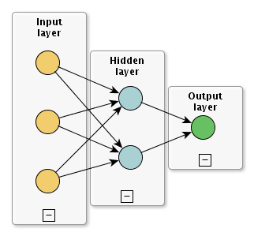
Neural Networks
Artificial Neural Networks
Mimic biological mammalian brains
Neuron is a processing element
Neurons connect to other neurons
Learn and adapt according to data
Network Topology
A directed graph with nodes representing each neuron
Input layer
Hidden layers
Output layer
Weights connecting each node
Transfer function

Slide 7
Genetic Algorithms
Genetic Algorithms
Modeled after Darwinian evolution
Chromosomes represent potential solutions
Typically encoded in binary
Every chromosome has a fitness score

Slide 8
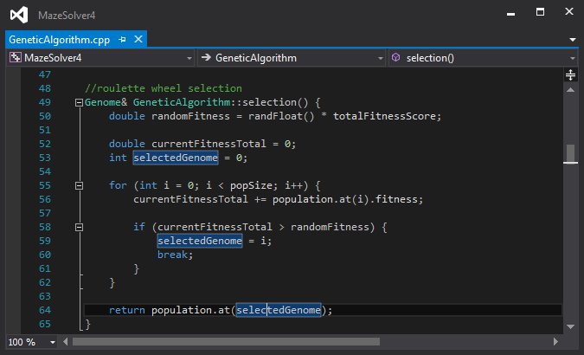
Genetic Algorithms
Selection
Chromosomes selected from
population for breeding
Various methods
Roulette Wheel Selection
Chromosomes selected based on
probability proportional to fitness

Slide 9
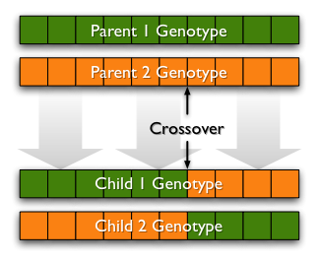
Genetic Algorithms
Crossover
Chromosome breeding
Several Methods
One point crossover
Based on crossover rate

Slide 10
Genetic Algorithms
Mutation
Chromosome mutated based on mutation rate
Trivial implementation
Every bit has small probability to get inverted

Slide 11
Genetic Algorithm
Loop until a solution is found:
1. Test each chromosome and assign fitness score
2. Select two members of current population
3. Crossover the bits from the chosen chromosomes at a randomly chosen point
4. Step through chromosome’s bits and invert depending on mutation rate
5. Repeat 2-4 until a new population is created

Slide 12
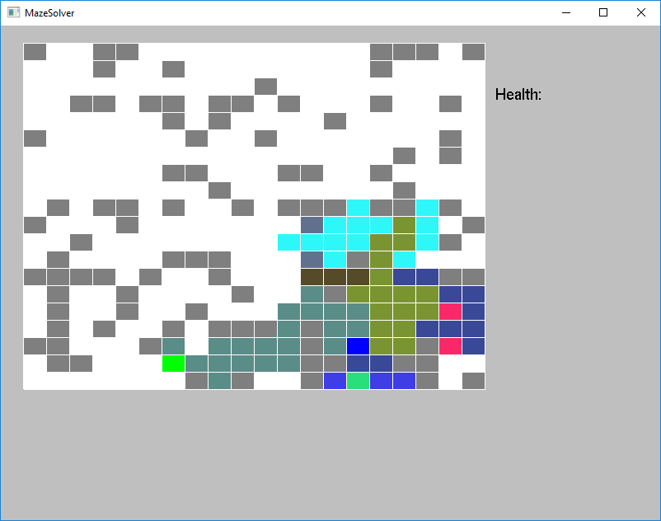
GA Maze Attempts
Colors represent different paths of chromosomes
Blue – Start
Green - Goal

Slide 13
Phase 4 Plans
Implement Neural Network
Modify Genetic Algorithm to train Neural Network weights
Make a better visual representation of NN/GA maze solutions
Tie up loose ends

